Slide 1
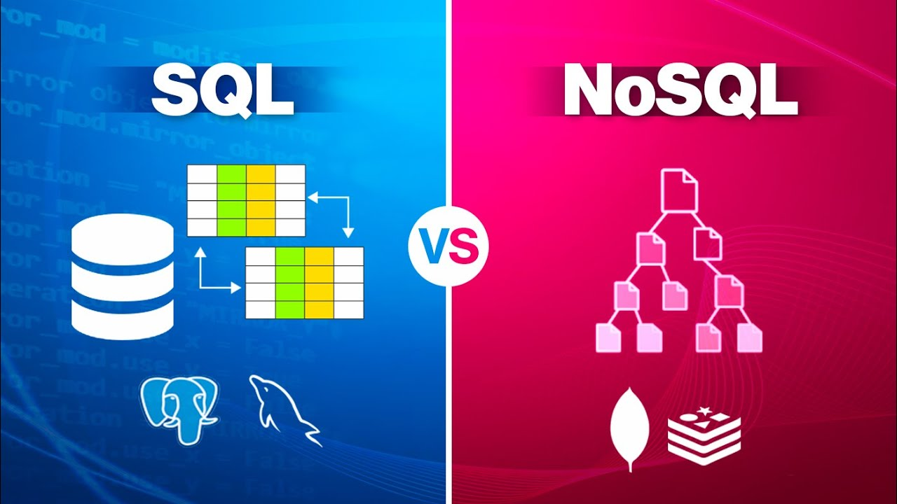

Slide 2
Introduction to SQL
For the deployment of Cloud applications, SQL Databases are typically used as Relational Databases. In addition to high-performance analytics, they provide various features for accessing, adding, managing, and processing data. It is a Database System that is easy to use, contains robust classification features, and offers uncomplicated reliability

Slide 3
Features of SQL
In general, SQL functions offer many features. • A SQL operation can easily be implemented using SQL procedural language statements and features, which allow you to integrate control-flow logic into conventional static and dynamic SQL statements. • A SQL function is usually more reliable than an equivalent external function. • Provide input parameters. • Scalar SQL functions return numerical values. • Provide a powerful but straightforward model for handling conditions and errors

Slide 4
Introduction to MongoDB
It’s an open-source, NoSQL document database. It is popularly used in conjunction with Amazon Web Services, Azure, and other data sources for application development and ongoing operation. In simple terms, MongoDB is a document-oriented database. This open-source product is developed and supported by 10gen.

Slide 5
Features of MongoDB
There are the following features of MongoDB:
There are multiple search options in MongoDB, including field, range, and regular expression categories.
Any area can index documents.
A load balancing configuration is automatically implemented because the data is split into shards.
It provides tools for map reduction and aggregation.
The code is written in JavaScript instead of Procedures

Slide 6
Conclusion
SQL databases are used to store structured data while NoSQL databases like MongoDB are used to save unstructured data.
MongoDB is used to save unstructured data in JSON format.
MongoDB does not support advanced analytics and joins like SQL databases support.
There are many good solutions available to support MongoDB analytics, including: data virtualization, translation, the MongoDB connector, and data warehousing with an ETL or ELT process.

